Slide 1
ZAS Academy
Python Curriculum for IOT & AI

Slide 2
Day3 - Agenda
Day 2 – Recap: Data Types (list vs array), Control Statements
Day 2 – Linear Search, Max/Min, Average/Total
Given an Integer Number or String – Reverse It
Nested Loops
Given an Array – Sort
Write a program from IGCSE Computer Science Chapter 9/10 Problem Set
IGCSE – Paper 2 (Reading Home Work)

Slide 3

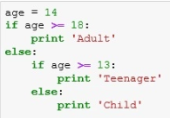
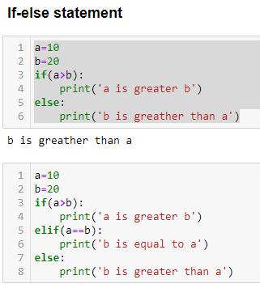
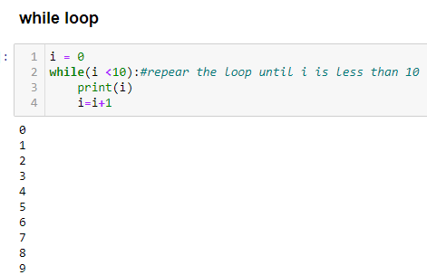
Recap – Day 1
Data Type
Int
Float
Double
String/Char
Lists
Arrays
Dictionary
Tuple
Control Statements
If-else
If-elif
For
while
Data Types
Control Statements

Slide 4
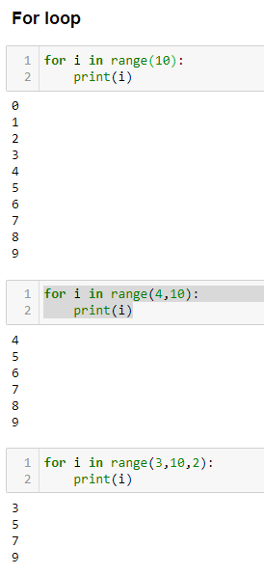
Recap – Day 1
Control Statements
If-else
If-elif
For
while

Slide 5
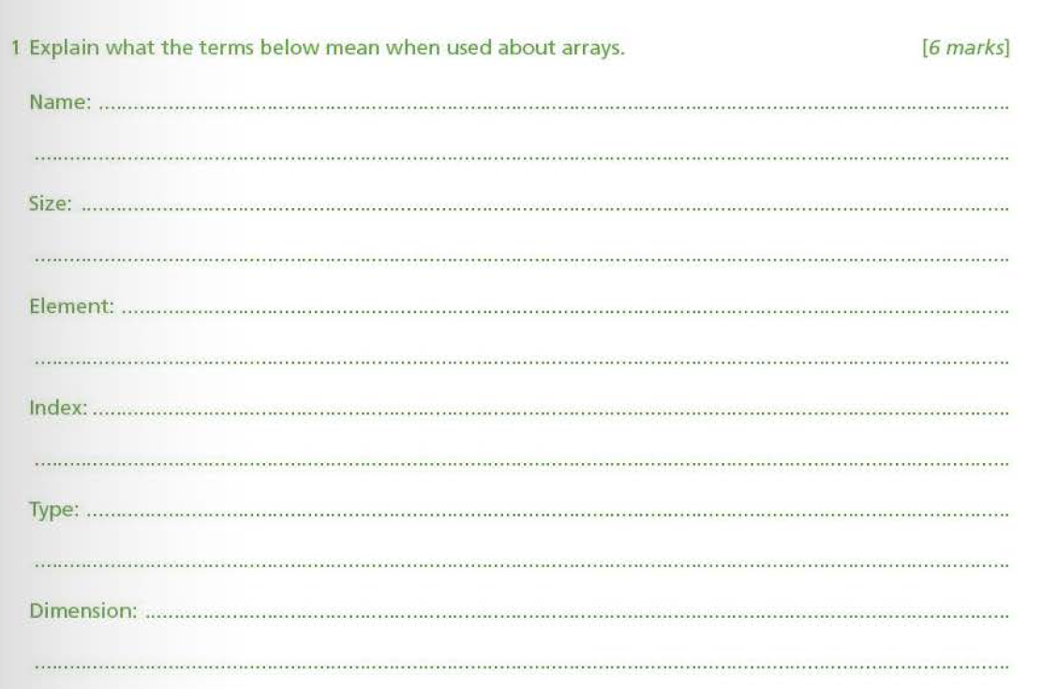
Known & Useful Functions:
len – to find the length of array or string
range(5) – starts i from 0 to 4 (doesn’t include 5) in increments of 1
range(2, 5) – starts i from 2 to 4 (doesn’t include 5) in increments of 1
range(3, 10, 2) – starts i from 3 to 9 (doesn’t include 10) in increments of 2
append(3) – to add an element to list or array

Slide 6
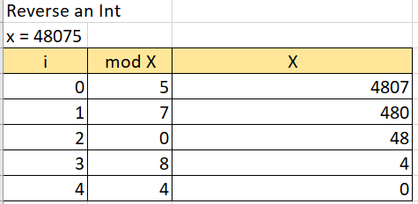
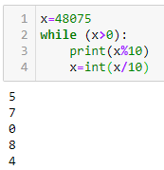
Reverse an Int
Modulus division→ 123 % 10 gives answer of 3 (remainder of 123/10)

Slide 7
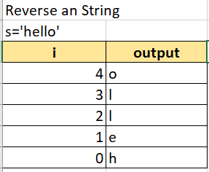
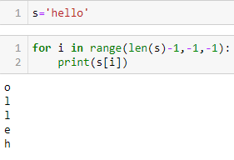
Reverse a String

Slide 8
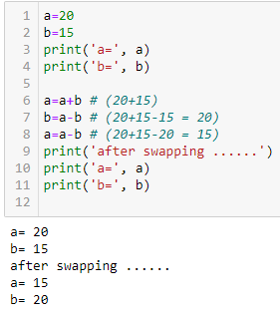
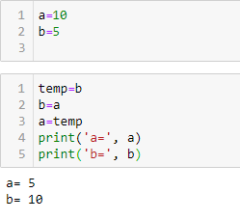
Swapping Variables
Without using a temporary variable
With a temporary variable

Slide 9
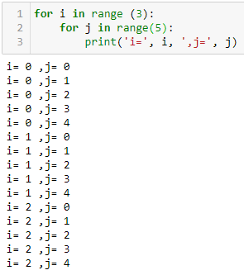
Nested Loops

Slide 10
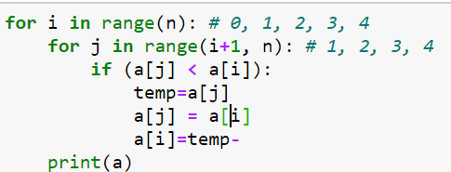
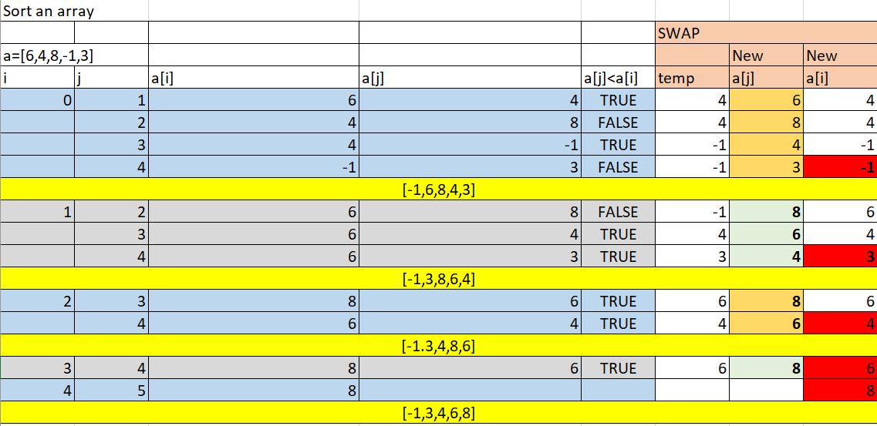
Sort a given Array

Slide 11
Sorting – 7 types of algorithms – bubble sort, heap sort…..
Searching
Trees
Graphs (network)
Linked Lists
Stacks
Queues

